Slide 1

BOOK RECOMMENDATION SYSTEM
TEAM-1
MENTOR – NEHA GUPTHA

Slide 2
BUSINESSS OBJECTIVE:
To Generate the features from Datasets and use them to recommend Books according to user.
Content:
The Book-Crossing dataset comprises 3 files.
Users : Contains the users. Note that user IDs (User-ID) have been anonymized and map to integers. Demographic data is provided (Location, Age) if available. Otherwise, these fields contain NULL-values.
Books:
Books are identified by their respective ISBN. Invalid ISBNs have already been removed from the dataset. Moreover, some content-based information is given (Book-Title, Book-Author, Year-Of-Publication, Publisher), obtained from Amazon Web Services. Note that in case of several authors, only the first is provided. URLs linking to cover images are also given, appearing in three different flavors (Image-URL-S, Image-URL-M, Image-URL-L), i.e., small, medium, large. These URLs point to the Amazon web site.

Slide 3
Ratings Contains the book rating information. Ratings (Book-Rating) are either explicit, expressed on a scale from 1-10 (higher values denoting higher appreciation), or implicit, expressed by 0.

Slide 4

During the last few decades, with the rise of Youtube, Amazon, Netflix, and many other such web services, recommender systems have become much more important in our lives in terms of providing highly personalized and relevant content.
The main objective is to create a recommendation system to recommend relevant books to users based on popularity and user interests.

Slide 5
Data Summary
The dataset is comprised of three csv files:: User, Books, Ratings
Users_dataset.
User-ID (unique for each user)
Location (contains city, state and country separated by commas
Age Shape of Dataset – (278858, 3)
Books_dataset.
ISBN (unique for each book)
Book-Title
Book-Author
Year-Of-Publication
Publisher
Image-URL-S
Image-URL-M
Image-URL-L
Shape of Dataset - (271360, 8)
Ratings_dataset.
User-ID
ISBN
Book-Rating
Shape of Dataset – (1149780 , 3)

Slide 6
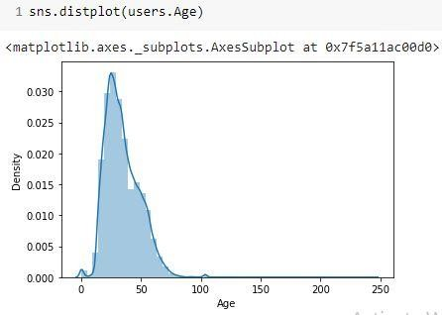
Observations from Users(Age)
The Age range given here is from 0 To 250.
Outliers in the Age column.

Slide 7
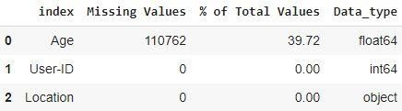
Data Cleaning
1. Null Value Imputation:
Age column has 40% missing values

Slide 8
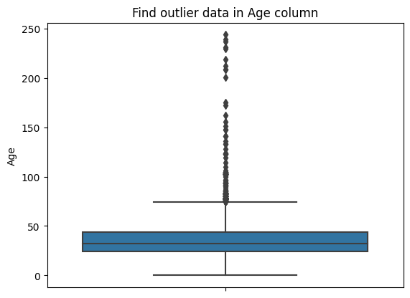
Imputing Missing Values
Outliers in Age columns
Age has positive skewness(Right tail)so we can use median to replace nan values

Slide 9
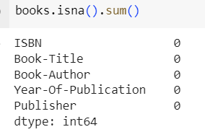
[ ]
Data Cleaning
1 . Null Value Imputation:

Slide 10
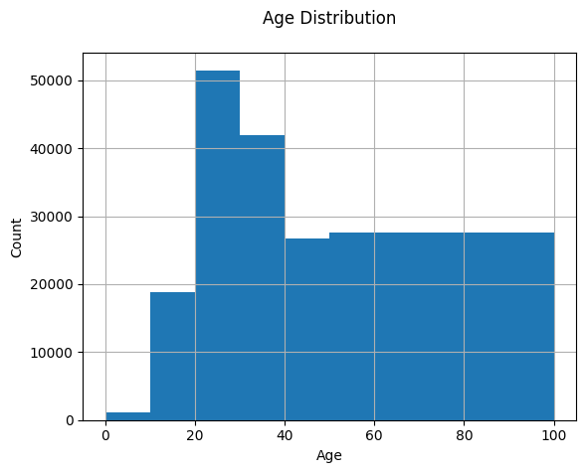
Observations from Users(Age)
The most active users are among those in their 20’s to 30’s.
The age range distribution is right skewed.

Slide 11
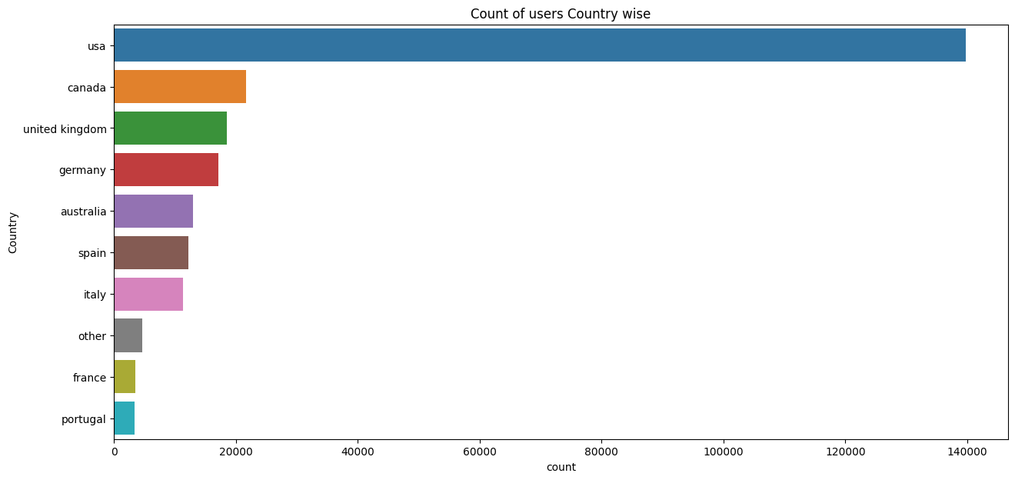
Observations from Users (Location)
Splitting Location column and analysing country.
Most active readers are from USA.

Slide 12
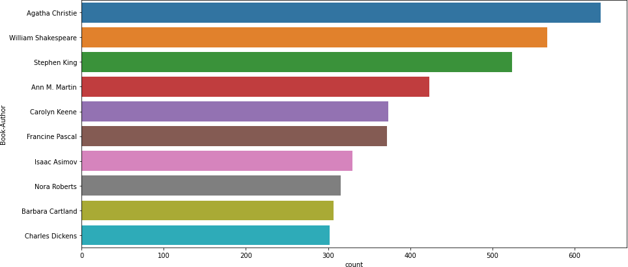
Observations from Books (Authors)
Agatha Christie wrote highest number of books in our given dataset

Slide 13
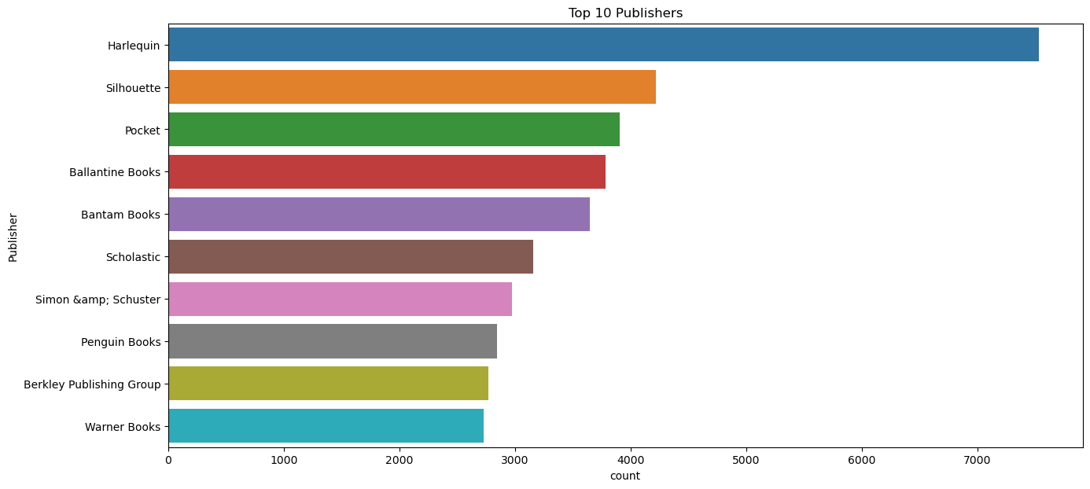
Observations from Books (Publishers)
Harlequin published highest number of books in our given dataset

Slide 14
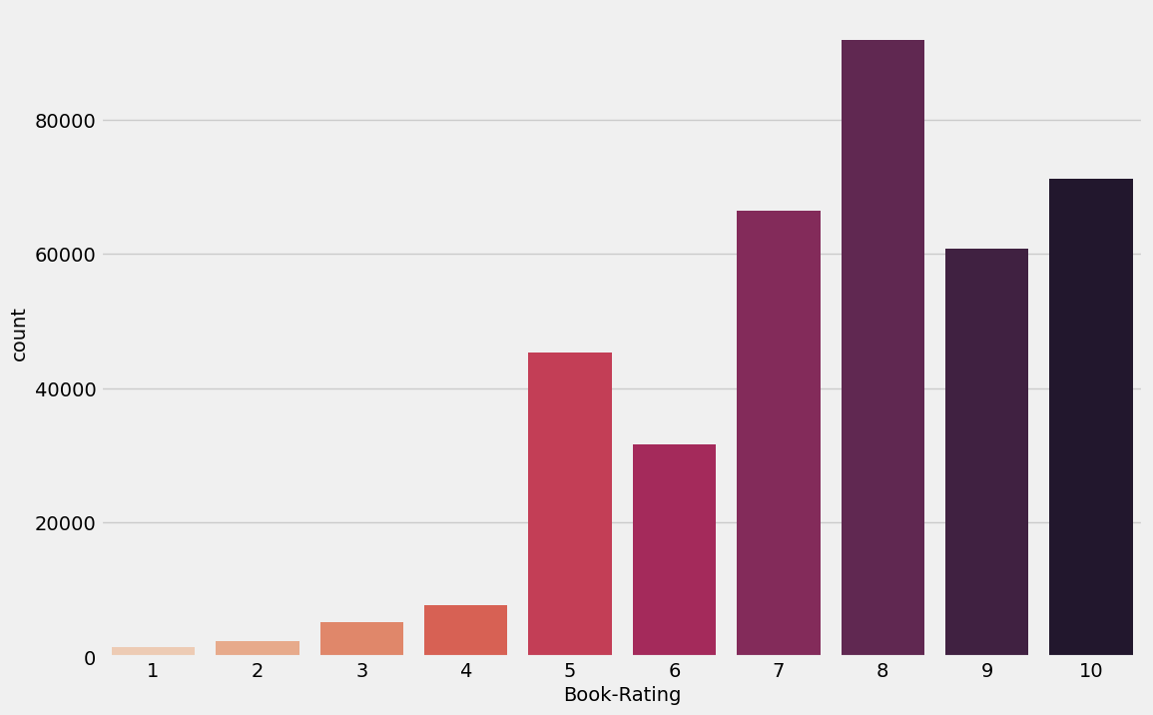
Observations from Ratings (Book_Rating)
Higher ratings are more common amongst users
Rating 8 has been rated the highest number of times

Slide 15
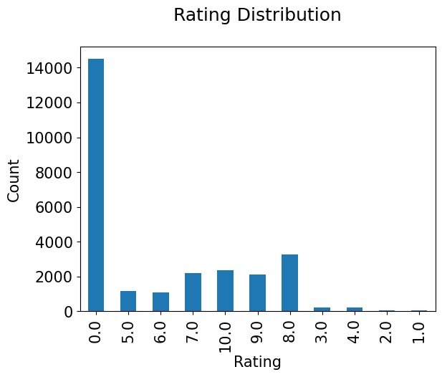
RATING DISTRIBUTION

Slide 16
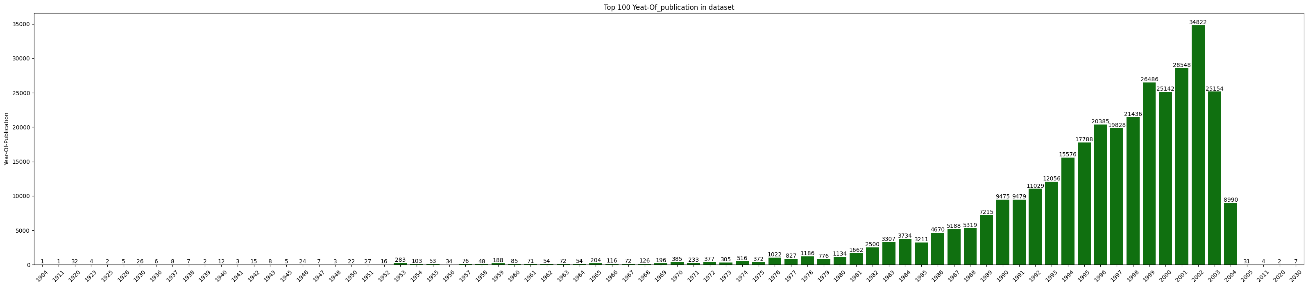
TOP 100 YEAR OF PUBLICATION

Slide 17
Different Models
1.)Popularity Based Recommendation
Book weighted average formula:
Weighted Rating(WR)=[vR/(v+m)]+[mC/(v+m)]
Where,
v is the number of votes for the books;
m is the minimum votes required to be listed in the chart; R is the average rating of the book; and
C is the mean vote across the whole report.

Slide 18
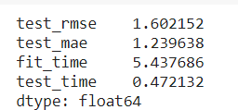
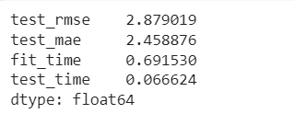
Different Models
1s
)
)
4
1s
1s
2.)Model based collaborative filtering
SVD
NMF

Slide 19
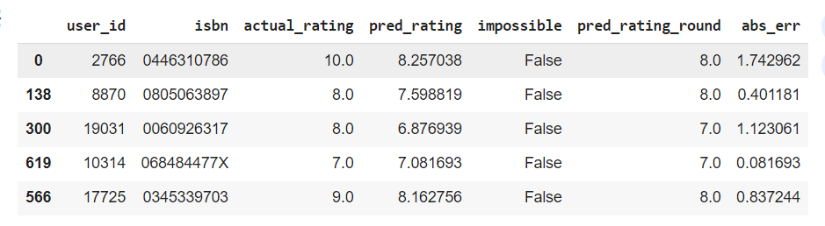
Different Models
SVD Model Results

Slide 20
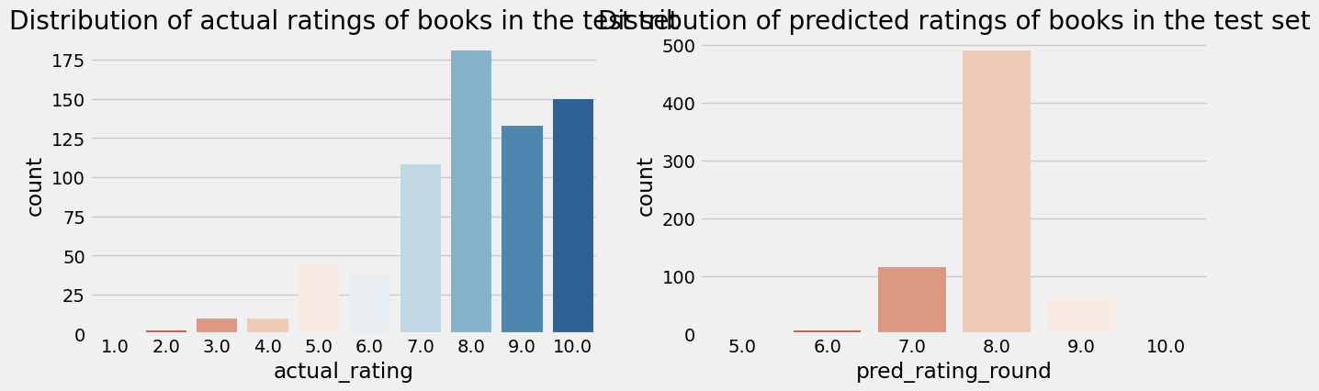
Different Models
SVD Model Results

Slide 21
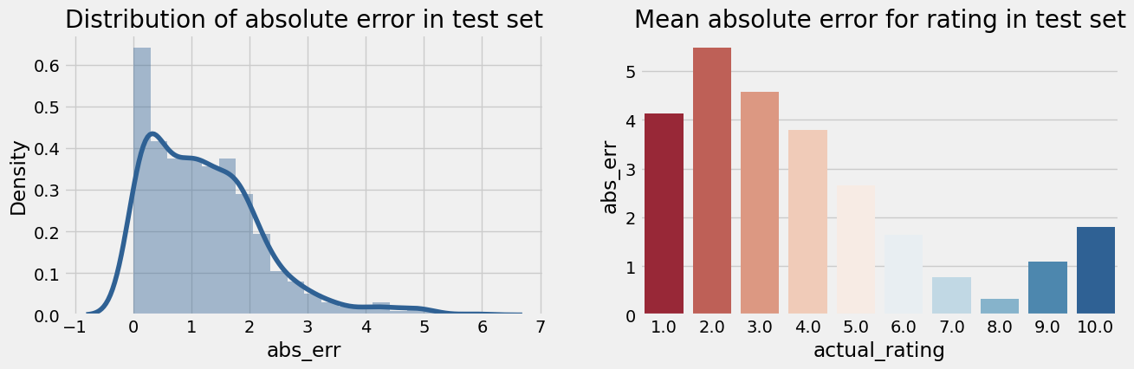
Different Models
SVD Model Results

Slide 22
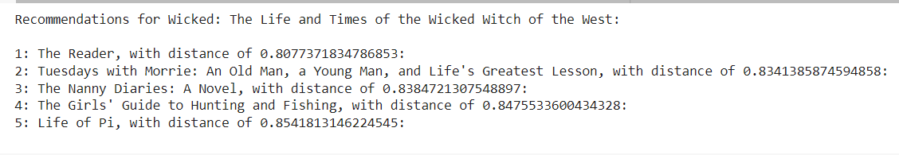
Collaborative Filtering-(User-User based)
3.)Collaborative Filtering-(User-User based)
Cosine Similarity
Nearest Neighbour

Slide 23
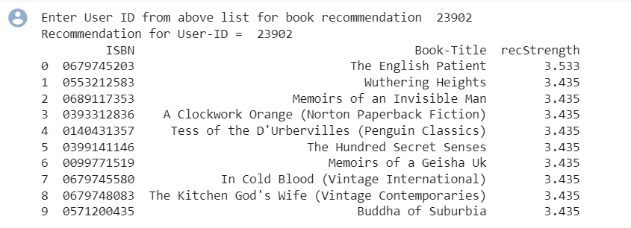
Different Models
4.)Collaborative Filtering-(User-Item based)

Slide 24
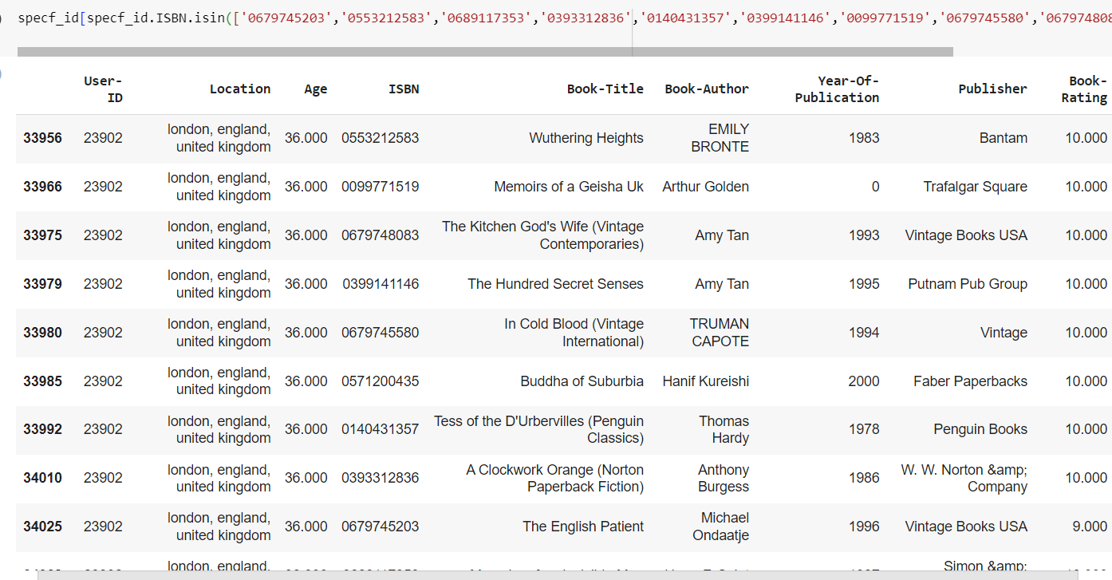

Slide 25
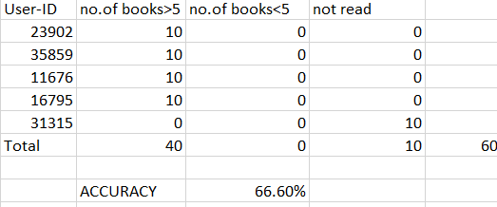
TABLE SHOWING EVALUATION

Slide 26
Conclusion
In EDA, the Top-10 most rated books were essentially novels. Books like The Lovely Bone and The Secret Life of Bees were very well perceived.
Majority of the readers were of the age bracket 20-35 and most of them came from North American and European countries namely USA, Canada, UK, Germany and Spain.
If we look at the ratings distribution, most of the books have high ratings with maximum books being rated 8. Ratings below 5 are few in number.
Author with the most books was Agatha Christie, William Shakespeare and Stephen King.
For modelling, it was observed that for model based collaborative filtering SVD technique worked way better than NMF with lower Mean Absolute Error (MAE) .

Slide 27
Conclusion
A recommendation system helps an organization to create loyal customers. The recommendation system today are very powerful that they can handle the new customer too who has visited the site for the first time. They recommend the products which are currently trending or highly rated and they can also recommend the products which bring maximum profitto the company.

Slide 28
THANK YOU

